Slide 1
What Do You Really Need?
Parent-Learning Session 2 – April 7, 2022

Slide 2
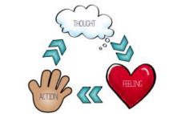
Our foundation for today: Choice Theory
Most kiddos I see come into therapy for unhelpful choices.
Here is where we can learn a bit about Choice Theory to help us
One of the basic premises in Choice Theory is that our thoughts and choices lead to our physiological responses and feelings. So, children come into therapy for overwhelming and uncomfortable feelings and physiological responses that are a product of thinking and choosing.
So....if we want to shift thinking and behavior then we have to explore what needs the behavior was attempting to meet!

Slide 3
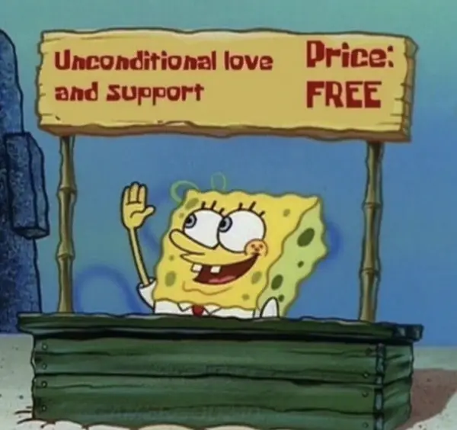
Uncovering the source…
One of the most important things in working with children (and humans) is identifying what is underneath the behavior.
And often, more than one need can be at play. If we can explore with children (as the expert in their world) what needs they were attempting to meet in a non judgmental way we can then begin to empower children to evaluate how effective or helpful their choice was.

Slide 4
5 basic needs
All behavior is an attempt to meet basic needs
  Motivation for all choices
  Misery is caused by unmet needs
    What does “misery” look like for your child? How do they express this?

Slide 5
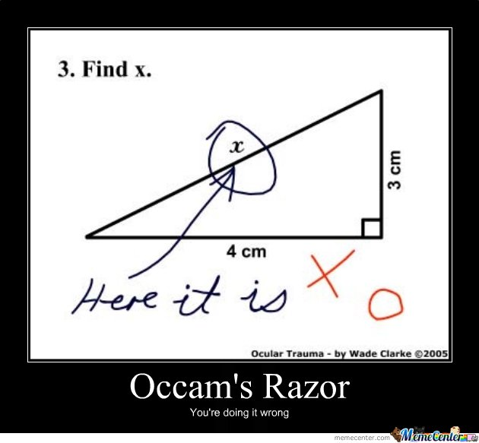
Survival
Physiological need for survival & sustaining life
  Examples:
    Food
    Clothing
    Shelter
    Physical safety
    Emotional safety
    Physical health

Slide 6
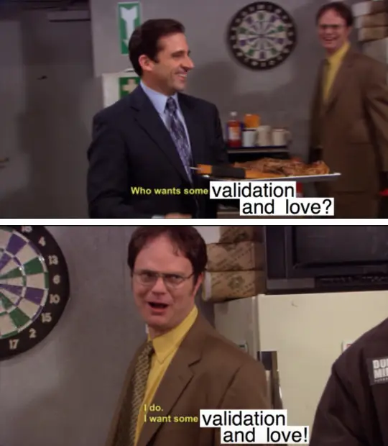
Love & Belonging
The drive & need to connect with others including friends, family, classmates, pets, spiritual communities, sports teams, online communities
  Examples:
    Feeling accepted by family
    Feeling like a part of a classroom
    Easily finding a partner or group for a project
    Having a friend to regularly connect with
    Having an online community
    Being part of a team
    Feeling like your pet likes you
    Having inside jokes with family and friends

Slide 7
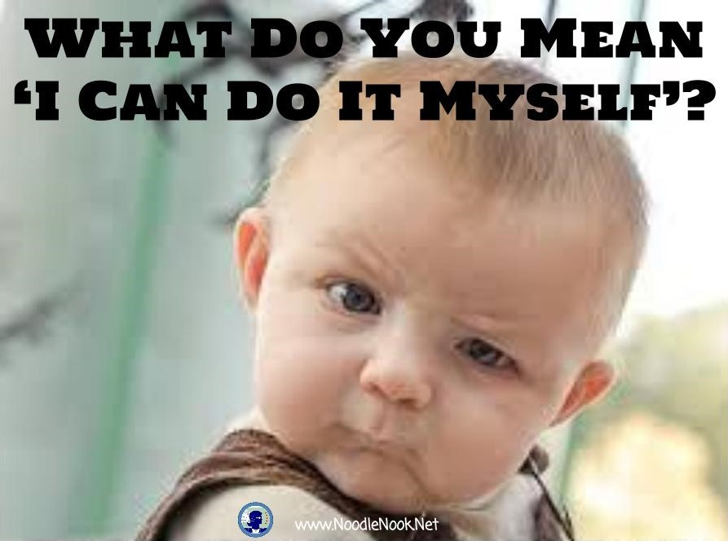
Freedom
The need to have age appropriate independence, choice, & autonomy being able to make choices without restriction, which also includes creative freedom.
  Examples:
    Choosing clothes
    Identifying activities you want to participate in
    Deciding how much to eat and what type of food
    Deciding when to do homework and chores
    Ability to go on a bike ride around the neighborhood
    Child managing homework/grades

Slide 8
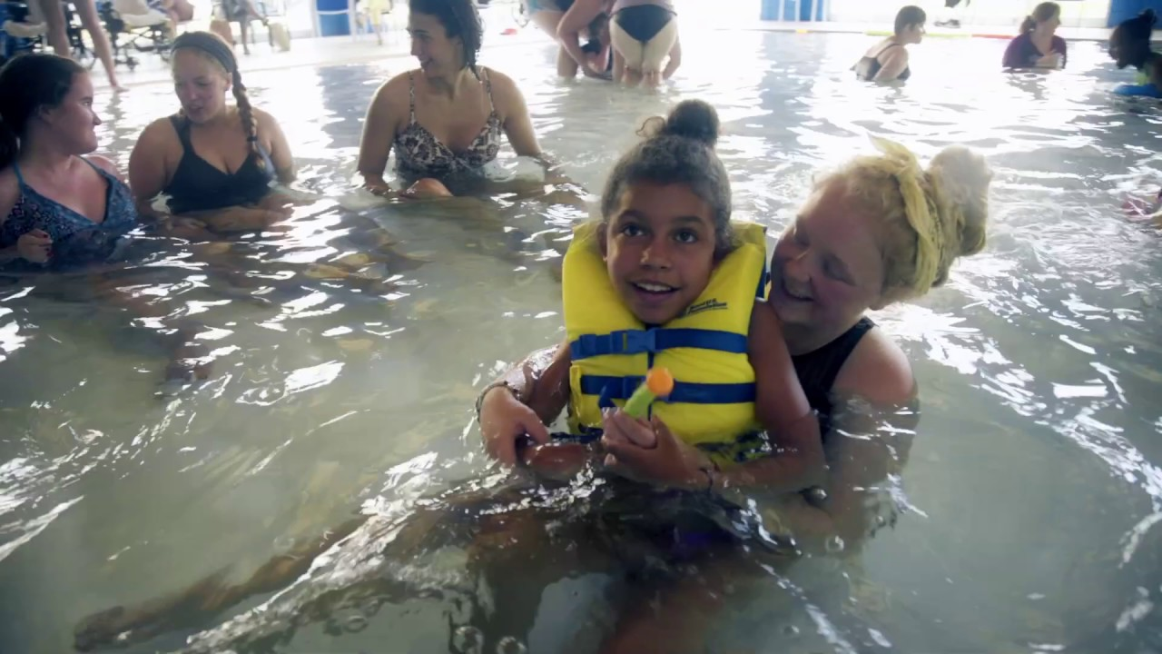
Power
The desire to matter, have competency, the ability to achieve & make a difference. To have purpose. This need encompasses self esteem & the desire to have an impact
  Examples:
    Winning a board game
    Having peers ask you for help in math
    Training someone at work
    Someone giving you a compliment
    Getting to the next level on a video game
    Being able to shoot a 3-point shot

Slide 9
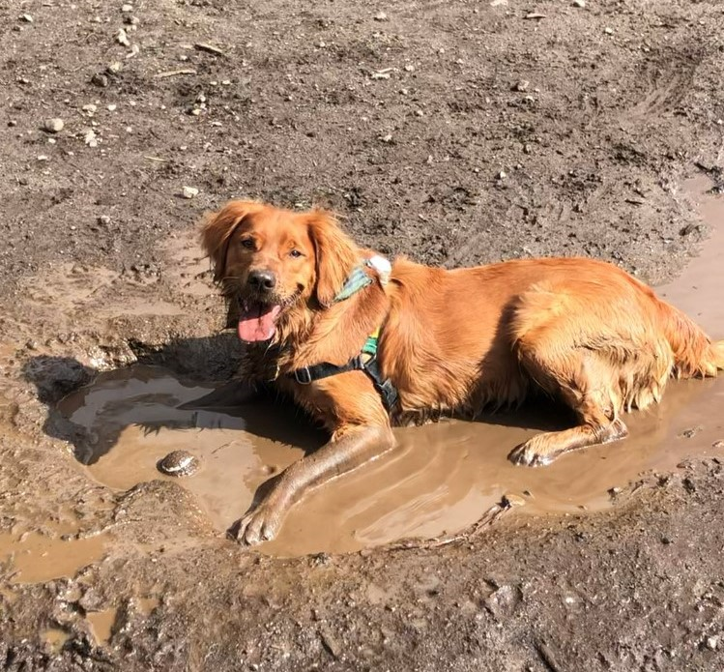
Fun!
The need for pleasure, play, humor, relaxation, & relevant learning
Only creature who play all our lives
  Examples:
    Tag
    Reading a book
    Listening to a meditation
    Playing hockey
    Telling jokes
    Making funny faces
    Playing a board game

Slide 10
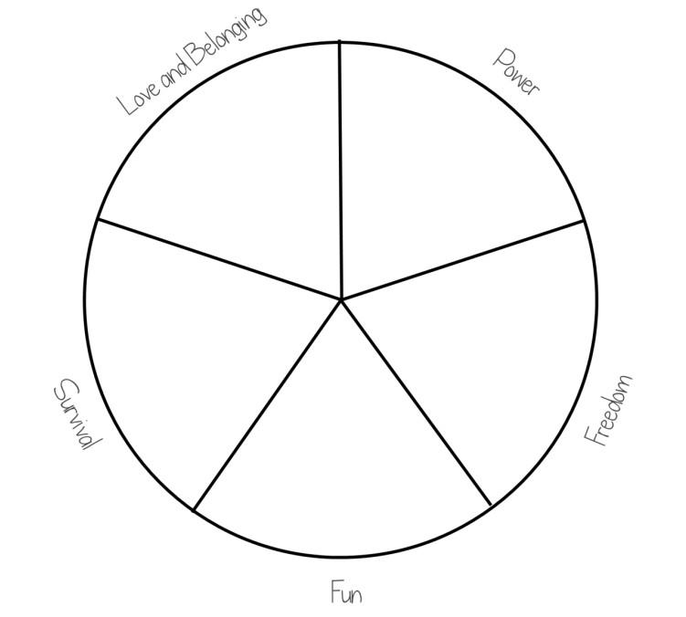
Recognize the deficits
Validation always produces gifts we can’t quite grasp in the moment
When we help our kids recognize where they are depleted, we are validating

Slide 11
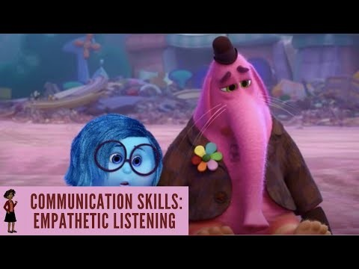
Can we spot Bing Bong’s needs deficit?

Slide 12
Disconnecting Habits:
Using Connecting Relationship Habits
Supporting
Encouraging
Listening
Accepting
Trusting
Respecting
Negotiating Differences
Complaining
Blaming
Criticizing
Nagging
Punishing
Threatening
Rewarding to control (bribing)

Slide 13
Help Your Child Name Their Options
The goal is not necessarily to pick an option, but to help your child feel less stuck by knowing what options are available
  You may have to present options, then allow your child to sit in discomfort for a bit
What are some examples of these options?
    Radical acceptance
    Confront your problem
    Choose something different
    Provide something immediate to fit your need
    Others you have used?

Slide 14
Resources
https://dochub.com/kward-mgh1vo/r4D6EkZVZoBnGGLwpQXW7O/mmhs-choice-theory-5-needs-handout-pdf
https://wglasser.com/quickstart-guide-to-choice-theory/#basic-needs
How to change the way you feel with the Feelings Wheel – RYNSKI COACHING CLUB (rynskirecovery.com)
To help kids find purpose:
  https://theparentcue.org/7-meaningful-activities-to-help-your-kids-find-purpose/
  https://greatergood.berkeley.edu/article/item/seven_ways_to_help_high_schoolers_find_purpose
Attention Isn’t a Dirty Word (meehanmentalhealth.com)
https://www.parentingforbrain.com/self-regulation-toddler-temper-tantrums/
https://mindfulnessexercises.com/recognizing-what-you-need/

